Slide 1
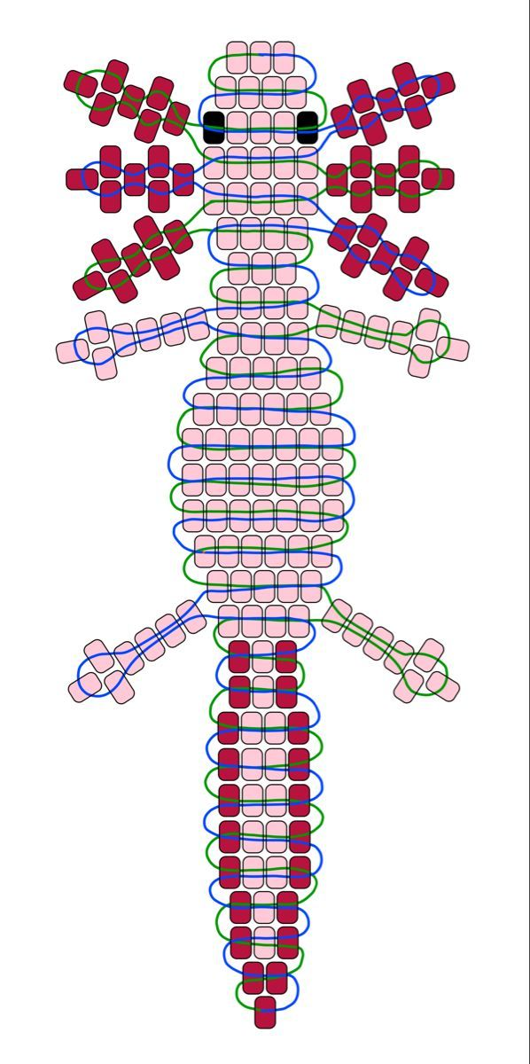
Color 3
Color 2
Color 1

